Slide 1
AI BLOGNEST API
AI-Powered Blog Management System
Node.js
Express.js
MongoDB
JWT
Gemini API
PROJECT TEAM
Susmitha M. • Sathya Priya A. • Suvasini E. • Shaheena M.

Slide 2
PROJECT OVERVIEW
A REST-based backend for intelligent blog creation and management
What is AI BlogNest?
Key Features
• Backend application built with Node.js and Express.js
• Manages users and blog content through REST APIs
• Uses Gemini AI for blog generation and summarization
• Stores application data securely in MongoDB
• User registration and login
• Secure JWT authentication
• Create, view, update and delete blogs
• AI-based blog generation
• Automatic content summarization
• JSON-based API responses

Slide 3
OBJECTIVES
Core goals of the project
1
Develop a RESTful blog management API.
2
Provide secure user authentication.
3
Store users and blogs using MongoDB.
4
Generate blog content using Gemini AI.
5
Summarize lengthy blog content automatically.
6
Create an efficient and scalable backend system.

Slide 4
TECHNOLOGIES USED
Technology stack powering the backend
BACKEND
DATABASE
AUTHENTICATION
• Node.js
• Express.js
• MongoDB
• Mongoose
• JWT
• bcrypt
AI INTEGRATION
TESTING
DEVELOPMENT
• Google Gemini API
• Thunder Client
• Visual Studio Code
• npm
• Nodemon

Slide 5
MAIN MODULES
Four functional areas of the system
01 USER AUTHENTICATION
02 BLOG MANAGEMENT
• Register
• Login
• Password encryption
• JWT authentication
• Create
• Read / View
• Update
• Delete
03 AI BLOG GENERATION
04 AI SUMMARIZATION
• Enter topic
• Gemini generates content
• Store generated blog
• Provide blog content
• Gemini processes content
• Generate short summary

Slide 6
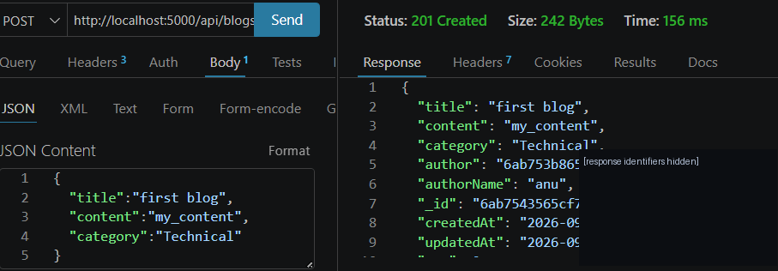
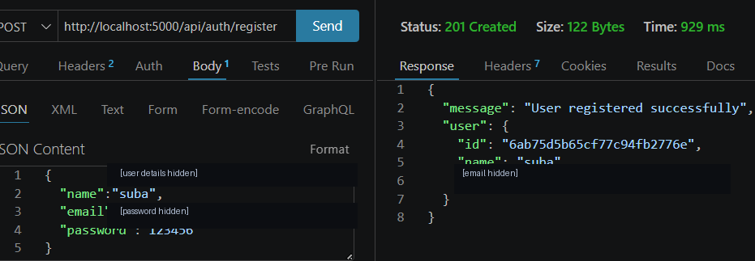
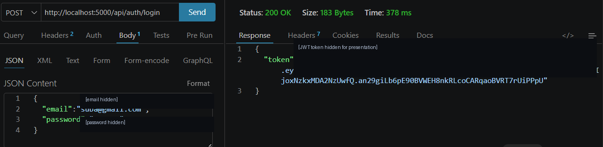
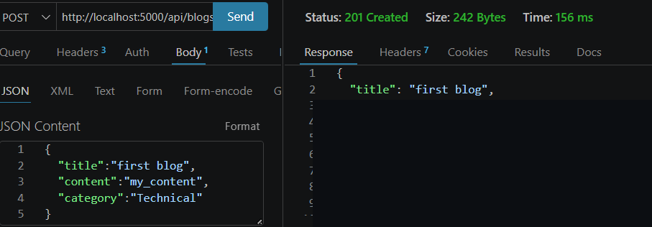
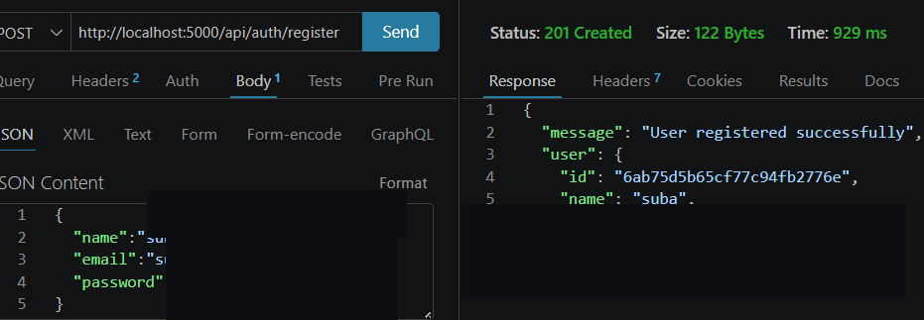
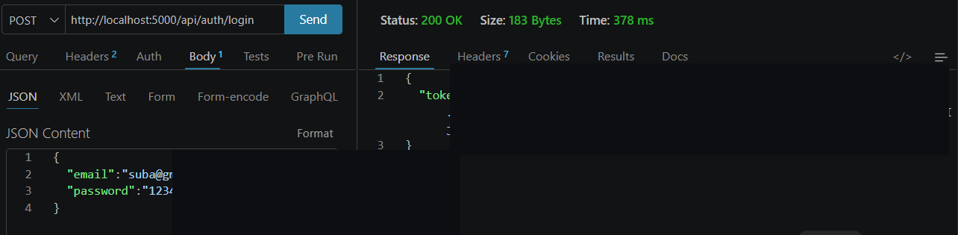
SYSTEM WORKFLOW & API TESTING
REST API flow validated in Thunder Client
USER
REST API
REQUEST
EXPRESS.JS
ROUTES
AUTH &
VALIDATION
CONTROLLER
GEMINI AI /
MONGODB
JSON
RESPONSE
THUNDER CLIENT — TEST RESULTS
CREATE BLOG API
USER REGISTRATION API
USER LOGIN API
✓ 201 Created • ✓ 200 OK • ✓ JSON responses verified

Slide 7
TEAM CONTRIBUTION & CONCLUSION
Professional team roles and project outcome
TEAM CONTRIBUTION
CONCLUSION
• Susmitha M. — Backend & API Development
• Sathya Priya A. — Database & Data Management
• Suvasini E. — AI Integration & Testing
• Shaheena M. — Documentation & Presentation
• Combines blog management with secure authentication.
• Uses MongoDB for reliable data storage.
• Integrates Gemini AI for generation and summarization.
• Provides a simple and efficient REST API backend.
• Designed for future scalability and feature expansion.
THANK YOU

